Slide 1
K Map Minimizer
Final Review

Slide 2
Team Members
01
02
03
Ashna Verma
Mariyam Siddiqui
Sneka J
20BEC1083
20BEC1077
20BEC1122

Slide 3
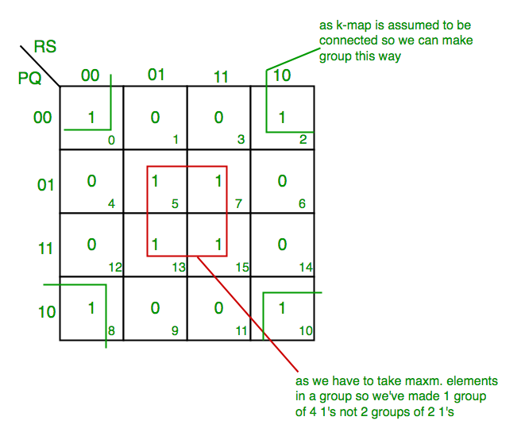
K-MAP
Karnaugh map method or K-map method is the pictorial representation of the Boolean equations and Boolean manipulations are used to reduce the complexity in solving them. These can be considered as a special or extended version of the ‘Truth table’.
By using Karnaugh map technique, we can reduce the Boolean expression containing any number of variables, such as 2-variable Boolean expression, 3-variable Boolean expression, 4-variable Boolean expression and even 7-variable Boolean expressions, which are complex to solve by using regular Boolean theorems and laws.

Slide 4
Problem Statement
The problems and shortcomings of the known methods for minimizing Boolean functions are associated with a rapid growth in the amount of computation, which results in an increase in the number of computational operations, and, consequently, in the increase in the number of variables of the logical function.
Simplification of Boolean expression is a practical tool to optimize programing algorithms and circuits.
Several techniques have been introduced to perform the minimization, including Boolean algebra (BA), Karnaugh Map (K-Map) and QM.

Slide 5
Literature Review
According to an article of International Journal of Computer Applications (0975 – 8887) Volume 15– No.7, February 2011 published by Arunachalam Solairaju Rajupillai Periyasamy , It is well known that the Karnaugh-map technique is an elegant teaching resource for academics and a systematic and powerful tool for a digital designer in minimizing low order Boolean functions. Why is the minimization of the Boolean expression needed? By simplifying the logic function, we can reduce the original number of digital components (gates) required to implement digital circuits. Therefore, by reducing the number of gates, the chip size and the cost will be reduced and the computing speed will be increased.
The K-map technique was proposed by M. Karnaugh . Later Quine and McCluskey reported tabular algorithmic techniques for the optimal Boolean function minimization.

Slide 6
Almost all techniques have been embedded into many computer aided design packages and in all the logic design university textbooks. In the present work, a well known modeling language, the object oriented technique is used for designing an Object-oriented model for Karnaugh map with the help of digital gates. An Object-oriented algorithm is also proposed for simplification of boolean functions through K-map. The basic concepts of digital circuit design are available in in many papers.
Normally a Boolean expression can be given using two forms:
1. 1 Sum-of-Products (SOP): This is the more common form of Boolean expressions. The expressions are implemented as AND gates (products) feeding a single OR gate (sum).
1. 2 Product-of-Sums (POS): This is less commonly used form of Boolean expressions. The expressions are implemented as OR gates (sums) feeding into a single AND gate (product).

Slide 7
Architecture of the Algorithm
We propose an algorithm for the minimization of n-variable Karnaugh map using Quine-Mc luscky algorithm and Petrick’s method.
Steps for our approach:
Separation all the minterms (and don’t cares) of a function into groups
Merge minterms from adjacent groups to form a new implicant table
Repeat step 2 until no more merging is possible
Put all prime implicants in a cover table (don’t cares excluded)
Recognize fundamental minterms, and henceforth basic prime implicants
Add prime implicants to the minimum expression of F until all minterms of F are covered.
So after simplification through QM method, a minimum expression for the function F is found.
https://www.tutorialspoint.com/digital_circuits/digital_circuits_quine_mccluskey_tabular_method.htm

Slide 8
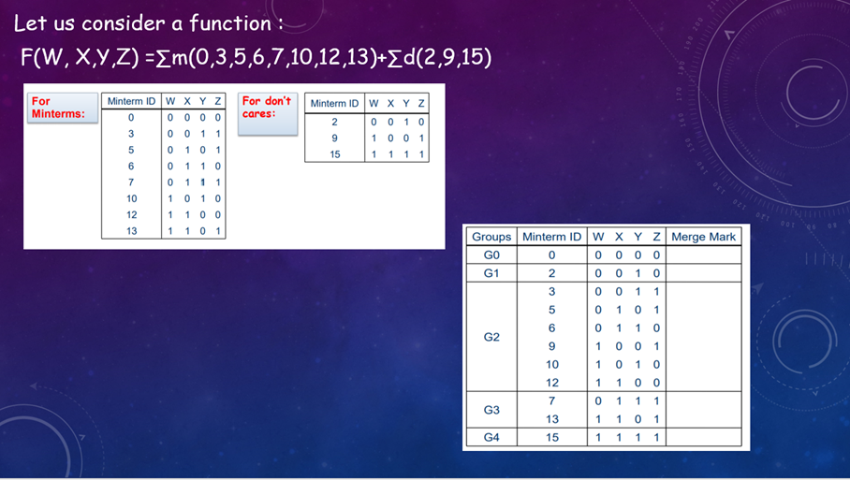

Slide 9
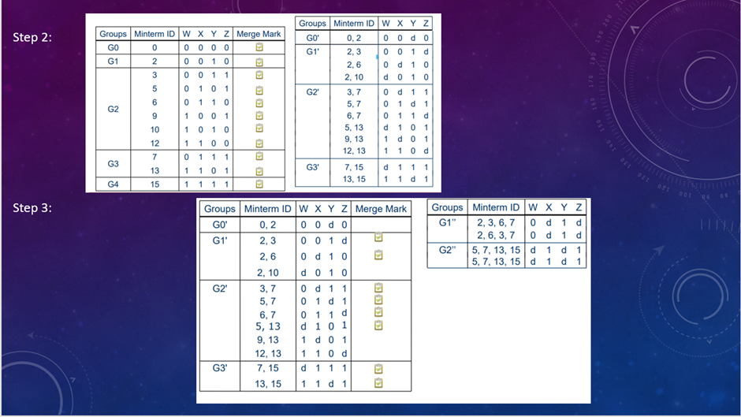

Slide 10
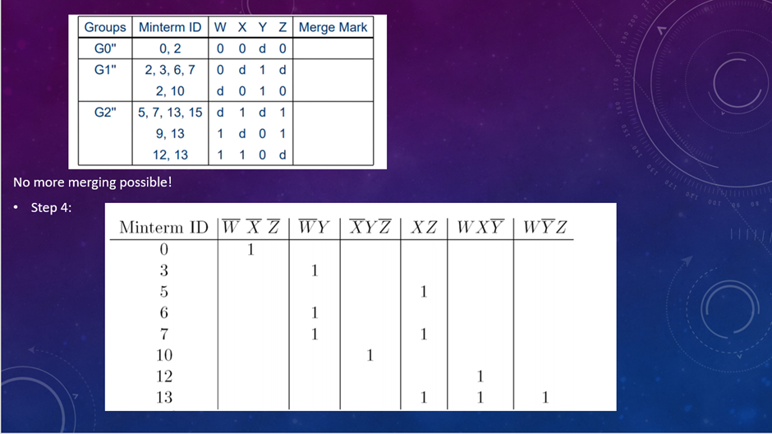

Slide 11
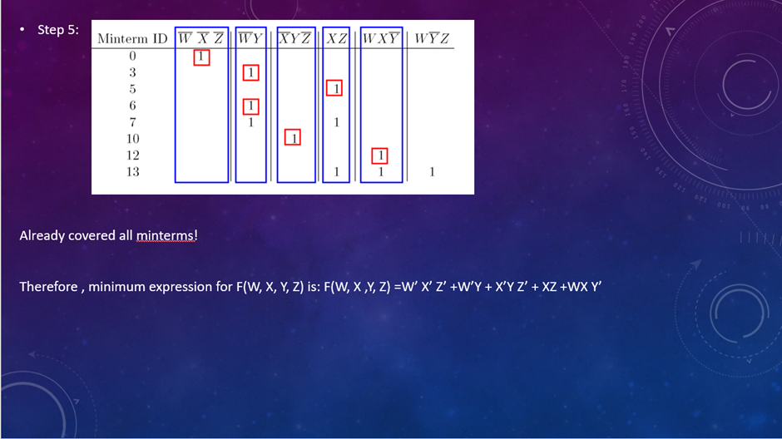

Slide 12
Code
https://github.com/mariyam-siddiqui/Quine-McKlusky/blob/main/qmcklusky.py

Slide 13
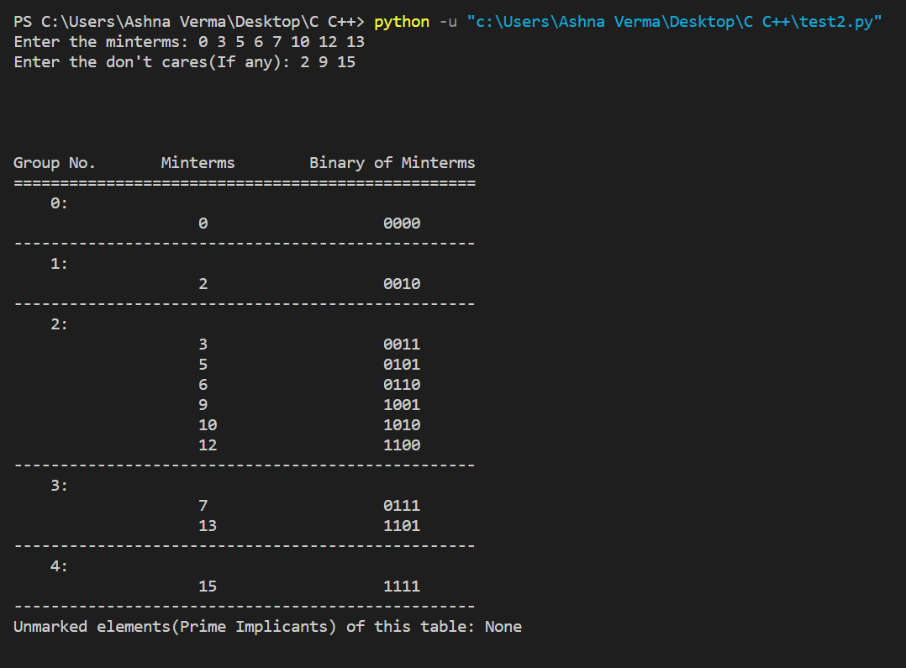
Results
INPUT:
F(P,Q,R,S)=∑(0,3,5,6,7,10,12,13)
Don’t cares= ∑(2,9,15)

Slide 14
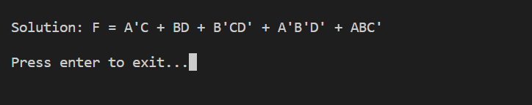

Slide 15
Conclusion
The Karnaugh Map Minimizer project is a useful tool for reducing logical expressions and simplifying the design of digital circuits. The program implements a step-by-step algorithm for minimizing Boolean expressions using Karnaugh maps, and it allows the user to input the Boolean expression or the truth table directly. The program outputs the simplified expression, which can be used to optimize the digital circuit design.
The Karnaugh Map Minimizer project demonstrates the power of Boolean algebra and the usefulness of Karnaugh maps in simplifying digital circuits. The implementation of the algorithm and the user-friendly interface make it easy for anyone to use the program to simplify their logical expressions. Overall, this project is a valuable tool for digital circuit designers and students learning digital design.

Slide 16
Thank you

Slide 17
Instructions for use
In order to use this template, you must credit Slidesgo by keeping the Thanks slide.
You are allowed to:
- Modify this template.
- Use it for both personal and commercial projects.
You are not allowed to:
- Sublicense, sell or rent any of Slidesgo Content (or a modified version of Slidesgo Content).
- Distribute Slidesgo Content unless it has been expressly authorized by Slidesgo.
- Include Slidesgo Content in an online or offline database or file.
- Offer Slidesgo templates (or modified versions of Slidesgo templates) for download.
- Acquire the copyright of Slidesgo Content.
For more information about editing slides, please read our FAQs or visit Slidesgo School:
https://slidesgo.com/faqs and https://slidesgo.com/slidesgo-school

Slide 18
Instructions for use (premium users)
As a Premium user, you can use this template without attributing Slidesgo or keeping the "Thanks" slide.
You are allowed to:
Modify this template.
Use it for both personal and commercial purposes.
Hide or delete the “Thanks” slide and the mention to Slidesgo in the credits.
Share this template in an editable format with people who are not part of your team.
You are not allowed to:
Sublicense, sell or rent this Slidesgo Template (or a modified version of this Slidesgo Template).
Distribute this Slidesgo Template (or a modified version of this Slidesgo Template) or include it in a database or in any other product or service that offers downloadable images, icons or presentations that may be subject to distribution or resale.
Use any of the elements that are part of this Slidesgo Template in an isolated and separated way from this Template.
Register any of the elements that are part of this template as a trademark or logo, or register it as a work in an intellectual property registry or similar.
For more information about editing slides, please read our FAQs or visit Slidesgo School:
https://slidesgo.com/faqs and https://slidesgo.com/slidesgo-school

Slide 19
Fonts & colors used
This presentation has been made using the following fonts:
Vidaloka
(https://fonts.google.com/specimen/Vidaloka)
Lato
(https://fonts.google.com/specimen/Montserrat)
#3f3533
#000000
#f5f2ee

Slide 20





Storyset
Create your Story with our illustrated concepts. Choose the style you like the most, edit its colors, pick the background and layers you want to show and bring them to life with the animator panel! It will boost your presentation. Check out how it works.
Pana
Amico
Bro
Rafiki
Cuate

Slide 21
Use our editable graphic resources...
You can easily resize these resources without losing quality. To change the color, just ungroup the resource and click on the object you want to change. Then, click on the paint bucket and select the color you want. Group the resource again when you’re done. You can also look for more infographics on Slidesgo.

Slide 24
JANUARY
FEBRUARY
MARCH
APRIL
MAY
JUNE
PHASE 1
Task 1
Task 2
PHASE 2
Task 1
Task 2
JANUARY
FEBRUARY
MARCH
APRIL
PHASE 1
Task 1
Task 2

Slide 27
...and our sets of editable icons
You can resize these icons without losing quality.
You can change the stroke and fill color; just select the icon and click on the paint bucket/pen.
In Google Slides, you can also use Flaticon’s extension, allowing you to customize and add even more icons.

Slide 28
Educational Icons
Medical Icons

Slide 29
Business Icons
Teamwork Icons

Slide 30
Help & Support Icons
Avatar Icons

Slide 31
Creative Process Icons
Performing Arts Icons

Slide 32
Nature Icons

Slide 33
SEO & Marketing Icons

Slide 34


